Slide 1

Optimizing Cloud Infrastructure selection for Diverse Businesses for KEYUP TECHNOLOGIES PRIVATE LIMITED, Bengaluru
Presented by
Monika Saradha 2228619

Slide 2
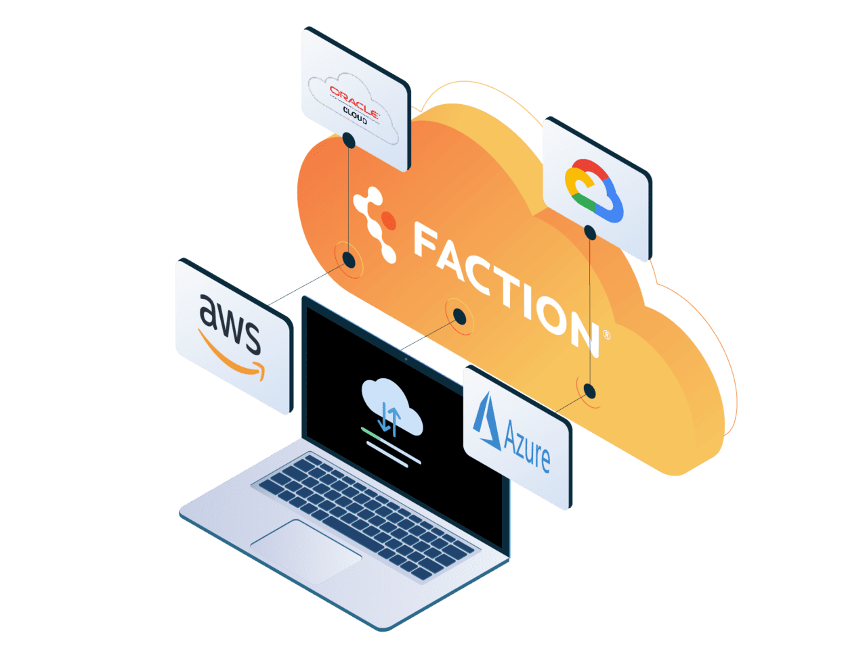
Industry Profile – Multi-cloud Service
Industry: Growing sector facilitating integration, management, and optimization of workloads across multiple cloud platforms.
Benefits: Flexibility, scalability, and resilience; minimizes vendor lock-in and optimizes cost management.
Drivers: Digital transformation and need for running applications where needed without complexity.
Flexibility and Portability: Built on open-source technologies like Kubernetes for efficient migration, building, and optimization of applications.
Alignment: Works well with DevOps and cloud-native technologies, enabling portability, scalability, and agility in application development and management.
Applications: Finance, Healthcare, E-commerce, Manufacturing, and Telecommunications.

Slide 3

Company Profile – KeyUp Technologies
Leading provider of cloud solutions and digital transformation services, empowering organizations to optimize their IT infrastructure and drive business success.
Offerings: Consultation, Managed services, Training & Support, Cloud solutions, DevOps and Automation solutions, Data Analytics & AI solutions.
Founded in 2021 - Sujith Chandra and Rallpali Ramachandra
KeyUp has 3 virtual offices worldwide
(https://keyuptek.com/)
Atlassian's IT Service Management software
Microsoft's comprehensive software stack
Hashicorp's suite of tools - Terraform, Vault, and Consul
Checkpoint perimeter security solutions
Colortokens' micro-segmentation solutions
Okta's solutions for Privileged Identity Management and Privileged Access Management
Automation Anywhere software

Slide 4

Project Design & Methodology
Problem Statement: In the current era of Web 2.0, the trend of on-premise software solutions have been overtaken by on-Cloud computing. Ease out the current limitations and tap into diverse offerings cloud becomes vital. Thus to address the challenge of optimizing cloud infrastructure selection for diverse businesses by evaluating the strengths and weaknesses of various cloud service providers.
Objectives:
Performance Evaluation of Azure and AWS instances
Cost Implication Analysis
Predictive Modeling: Forecast the costs of Azure and AWS instances
Cost Optimization Model: Identify the most cost-efficient configurations
Identify common factors influencing the choice of cloud service providers in the FMCG and Healthcare sectors

Slide 5
Continued…
Data Collection: Azure and AWS instances, including performance metrics, specifications, and pricing information from open source datasets and websites.
Recent articles on specific companies from FMCG and Healthcare and their comments on Cloud services.
Data Preprocessing: Clean, Missing Value Analysis, and ensure data consistency.
TA: Removal of HTML tags, punctuation, and stop words. Tokenization, stemming, and lemmatization.
EDA: To understand the distribution, patterns, and relationships of the variables.
Performance Analysis: CPU utilization, memory usage, and network performance, compare and identify the best service under different instances.
Cost Implication Analysis: Calculate cost metrics, conduct cost comparisons, and visualize cost data.

Slide 6
Continued…
Predictive Modelling: Using Linear Regression and Random Forest - Evaluate the model's performance using metrics such as mean squared error (MSE), R-squared, or root mean squared error (RMSE).
Cost Optimization Model: Random Forest Regressor based on MSE, RMSE and MAE. Compared with actual test data for accuracy and reliability.
Cloud Service Provider Identification: Using NLP, extract cloud mentions of specific company
Topic Analysis with LDA: Group words into topics, identify themes in cloud-related content within the FMCG and healthcare industries.
Programming Language: Python Colab

Slide 7
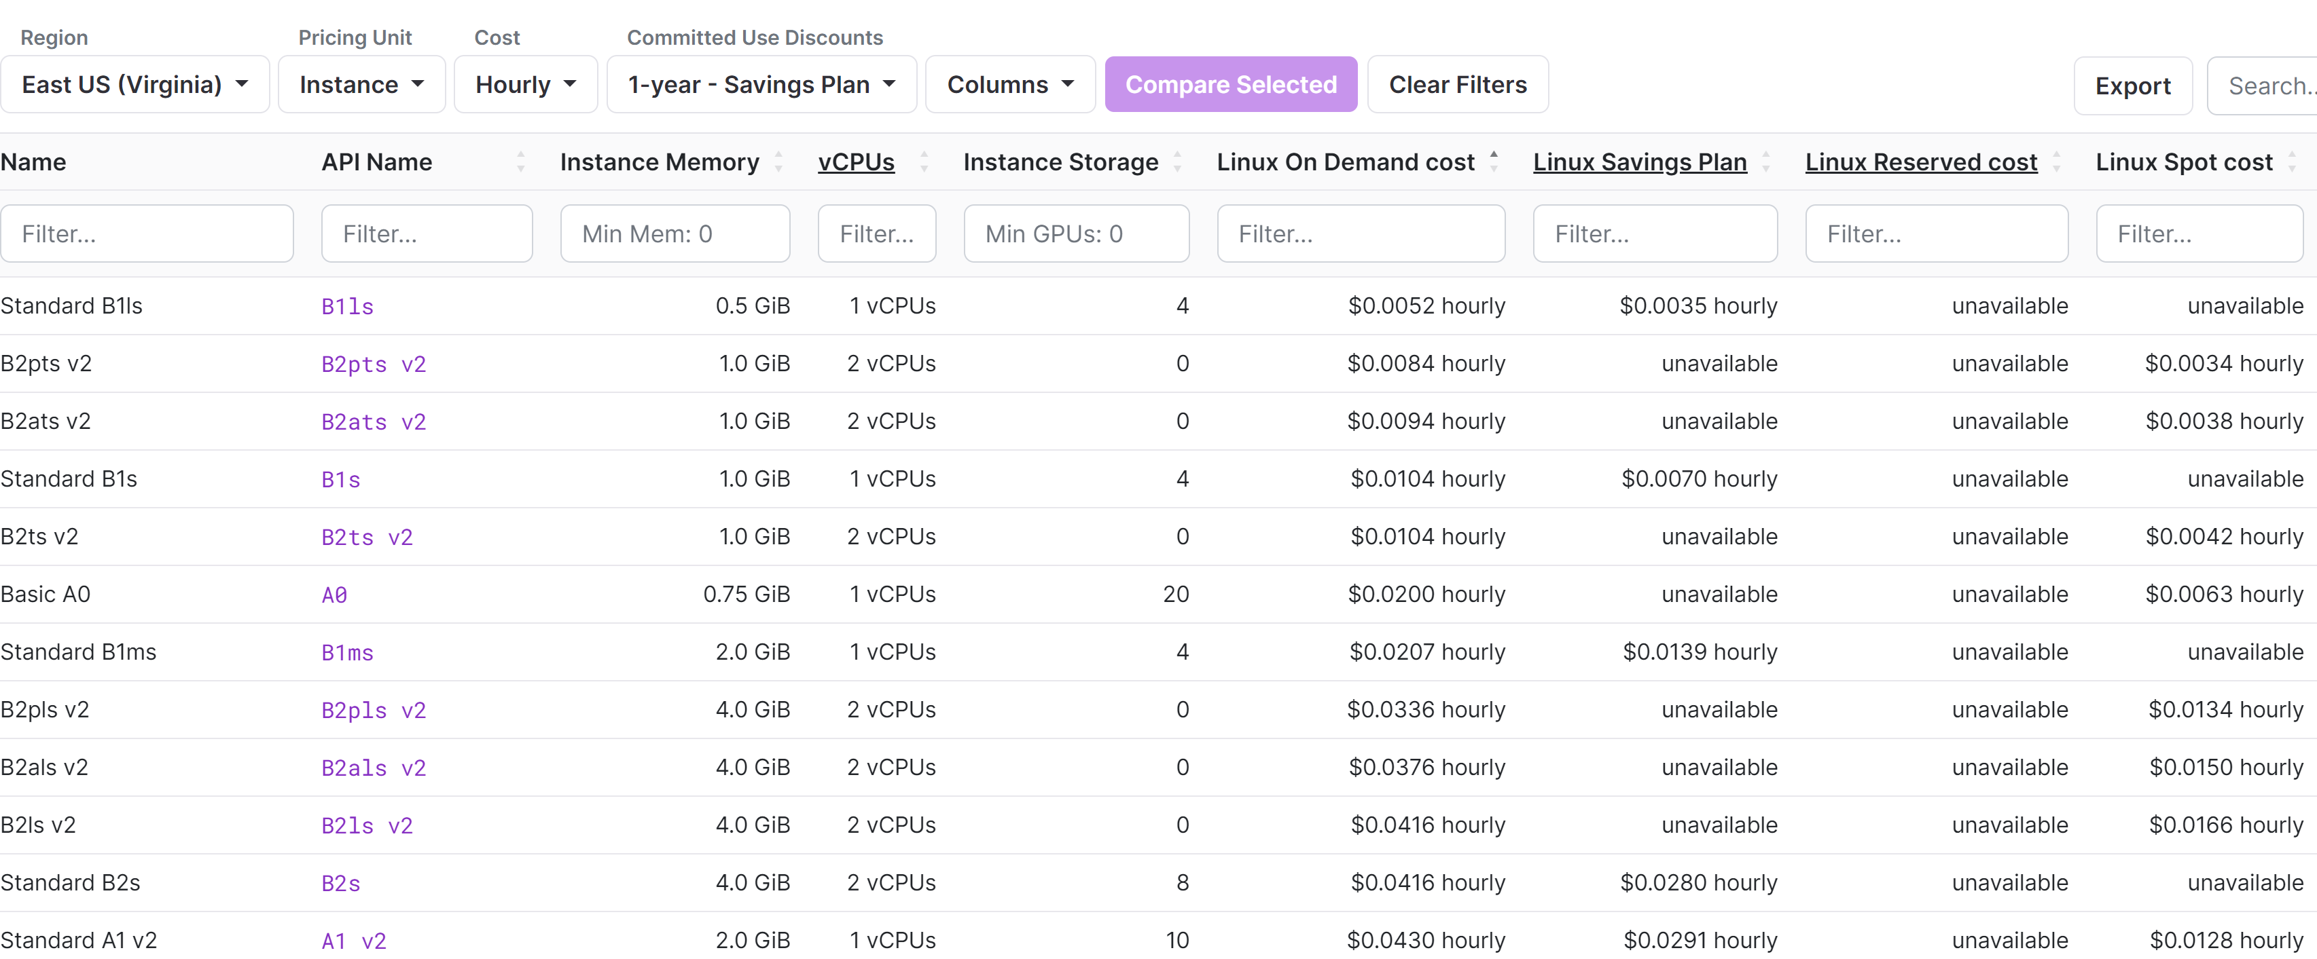
Data Analysis & Interpretation
Dataset: AWS EC2 and Microsoft Azure VM
Region: East US (Virginia)
Source: Vantage

Slide 8
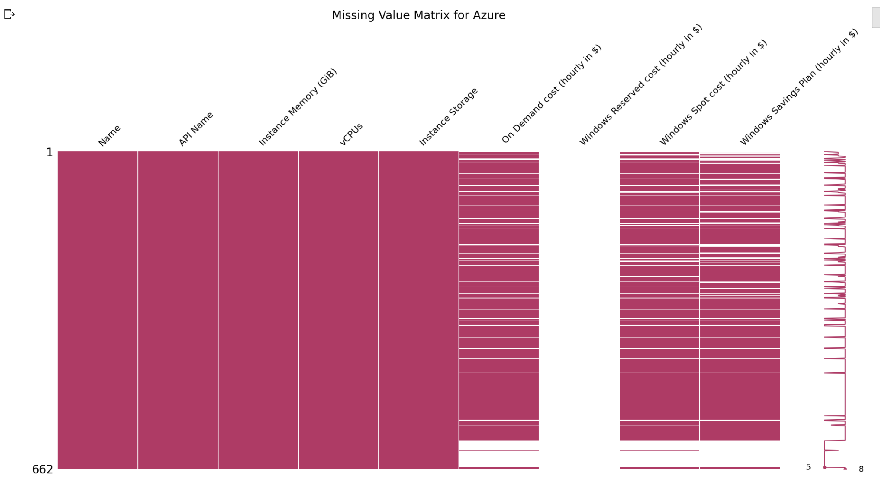
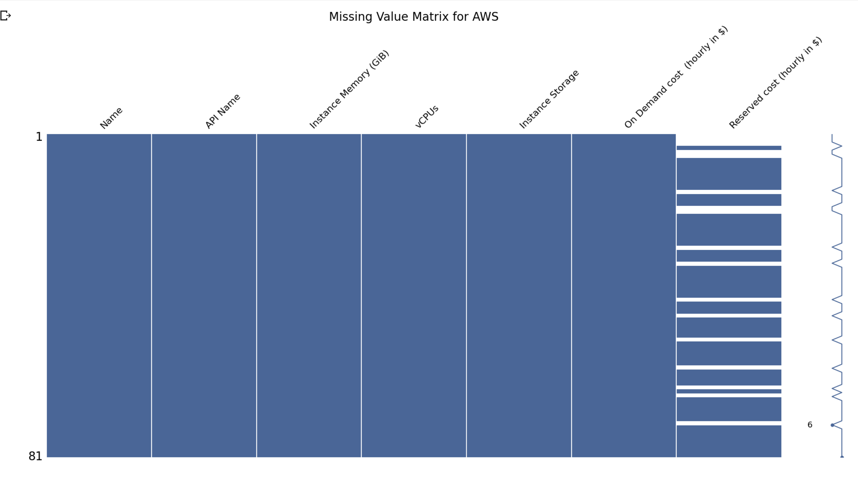
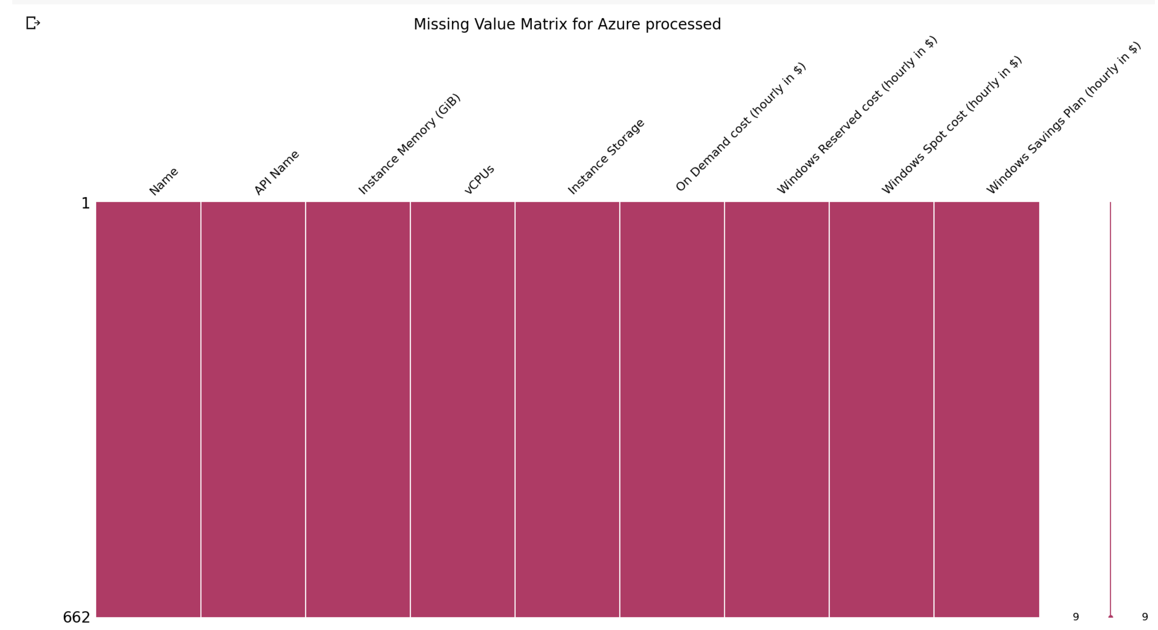
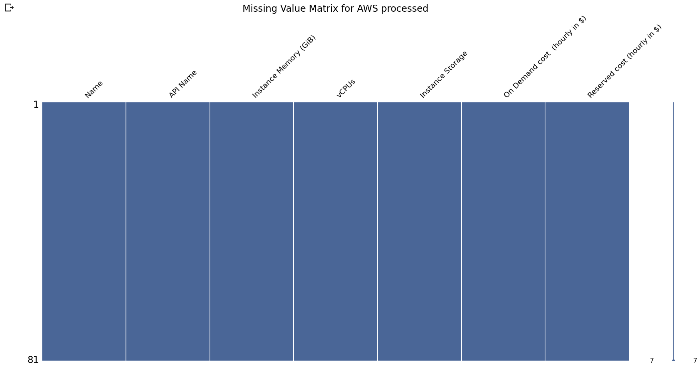
Data Cleaning & Preprocessing
The missing values were dealt with by replacing them by their mean values.

Slide 9
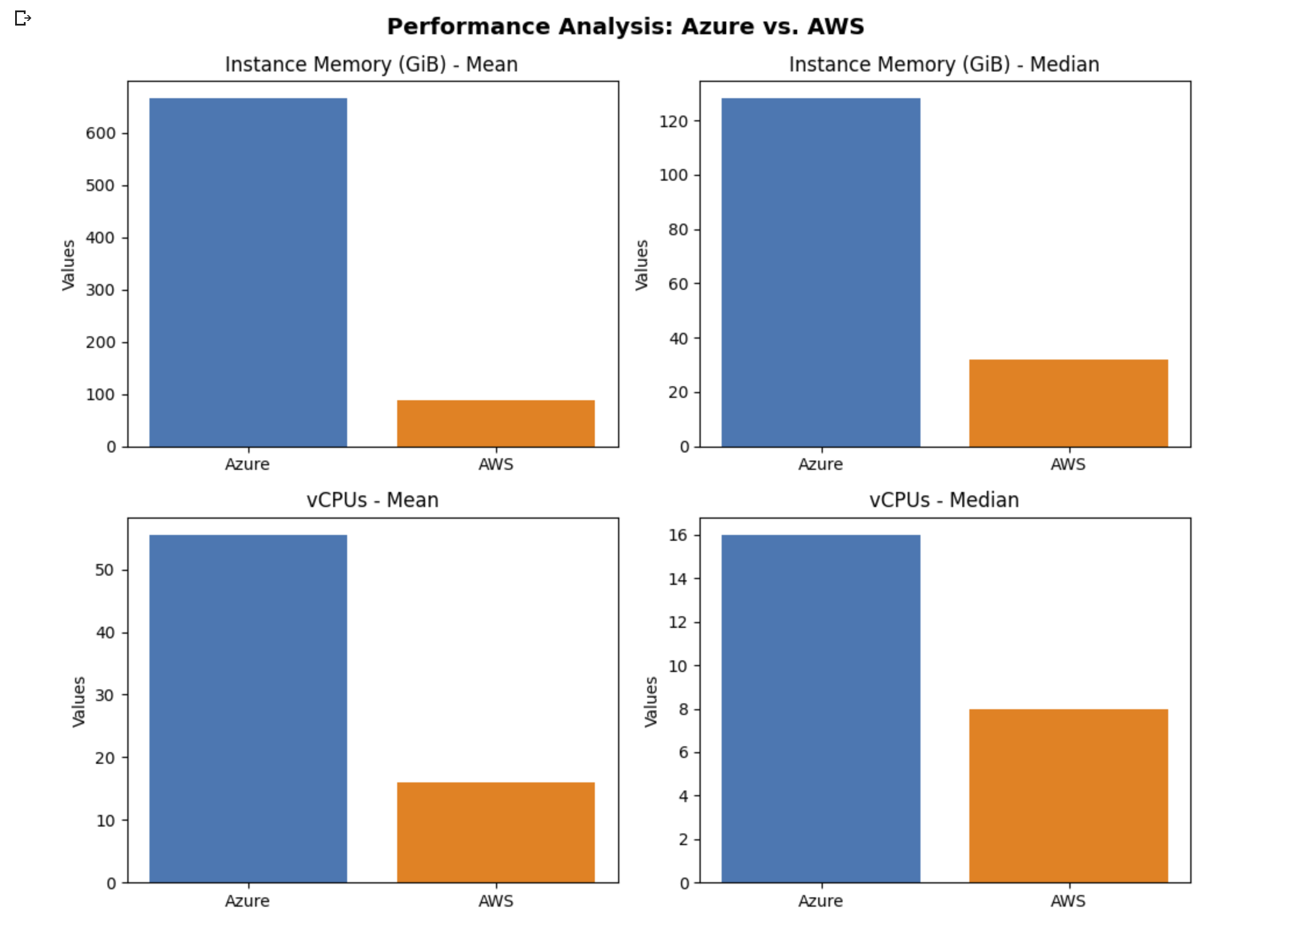
Performance Analysis AWS & Azure
Instance Memory (GiB): Azure is statistically better, indicating larger distribution of memory capacity, including instances with higher memory.
vCPUs: They offer a comparable computational power

Slide 10
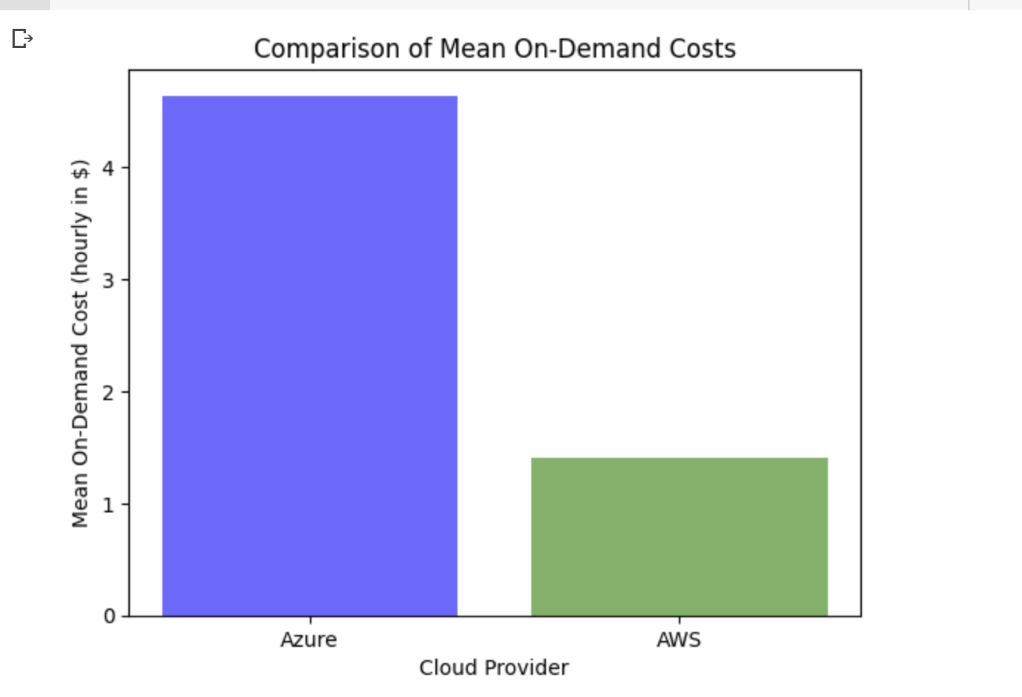
Cost Implication Analysis
Azure has a higher mean On-Demand Cost compared to AWS, meaning running instances on Azure generally comes at a higher cost per hour compared to AWS.
Factors that affect On-Demand Costs are instance types, regions and configuration.

Slide 11
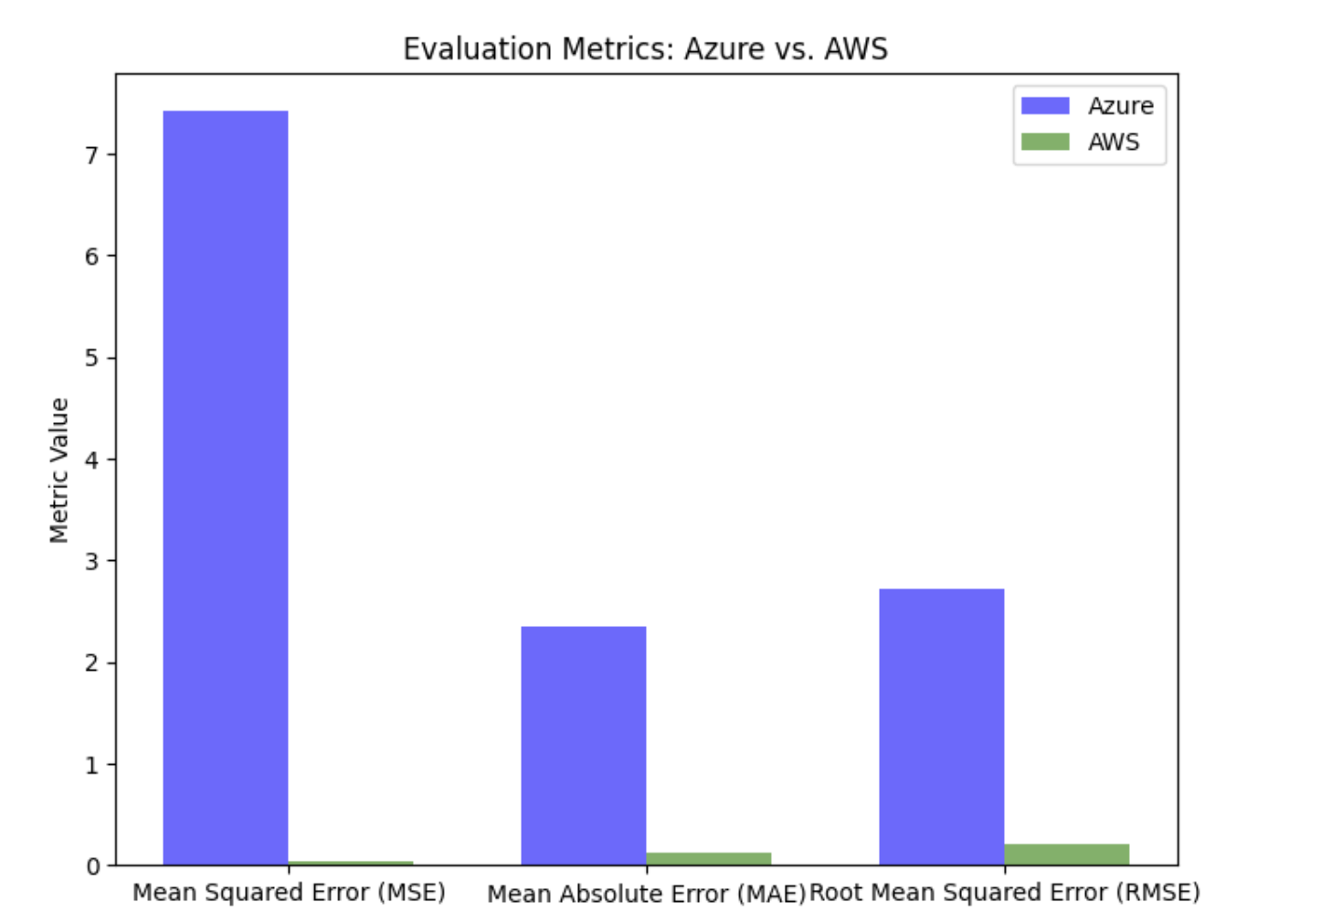
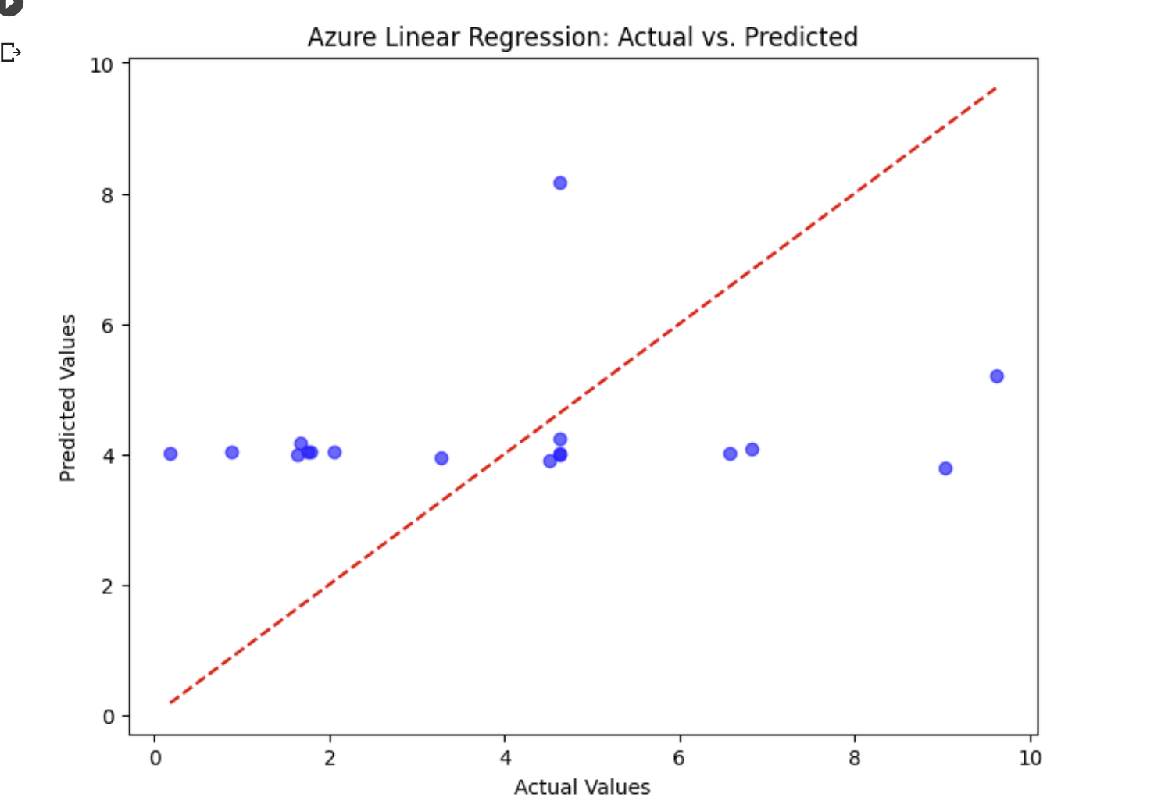
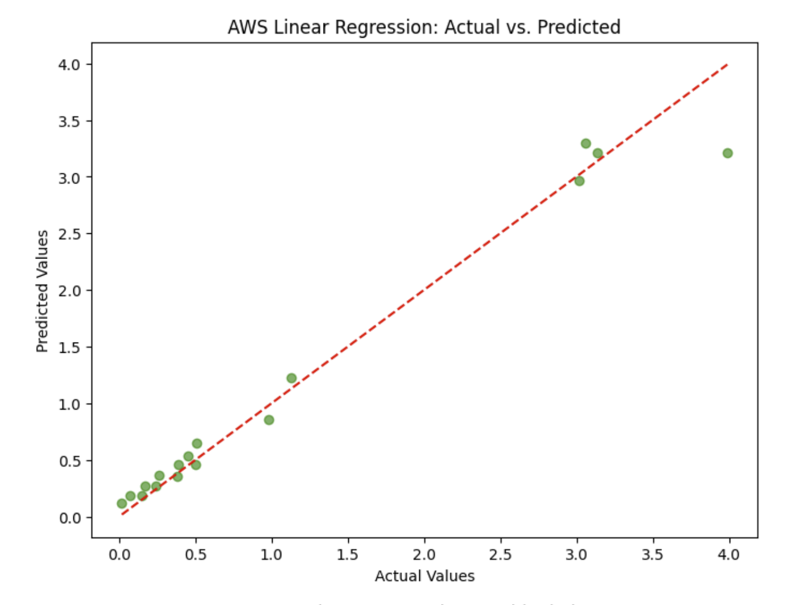
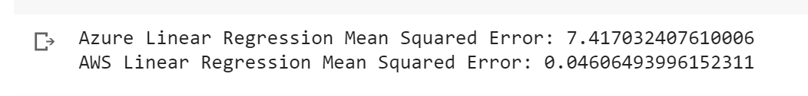
Predictive Modelling – Linear Regression
AWS model provides a better fit to the data and exhibits higher accuracy in predicting the target variable.
Target Variable - Cost
Evaluation metrics - Instance Memory (GiB), vCPUs & Instance Storage.

Slide 12
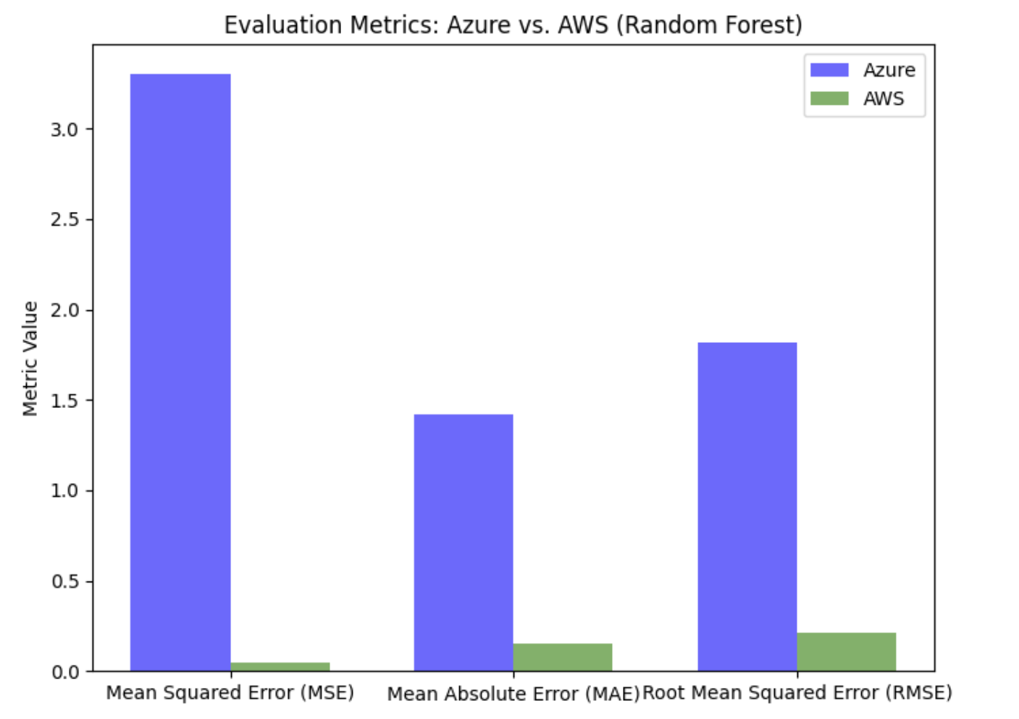
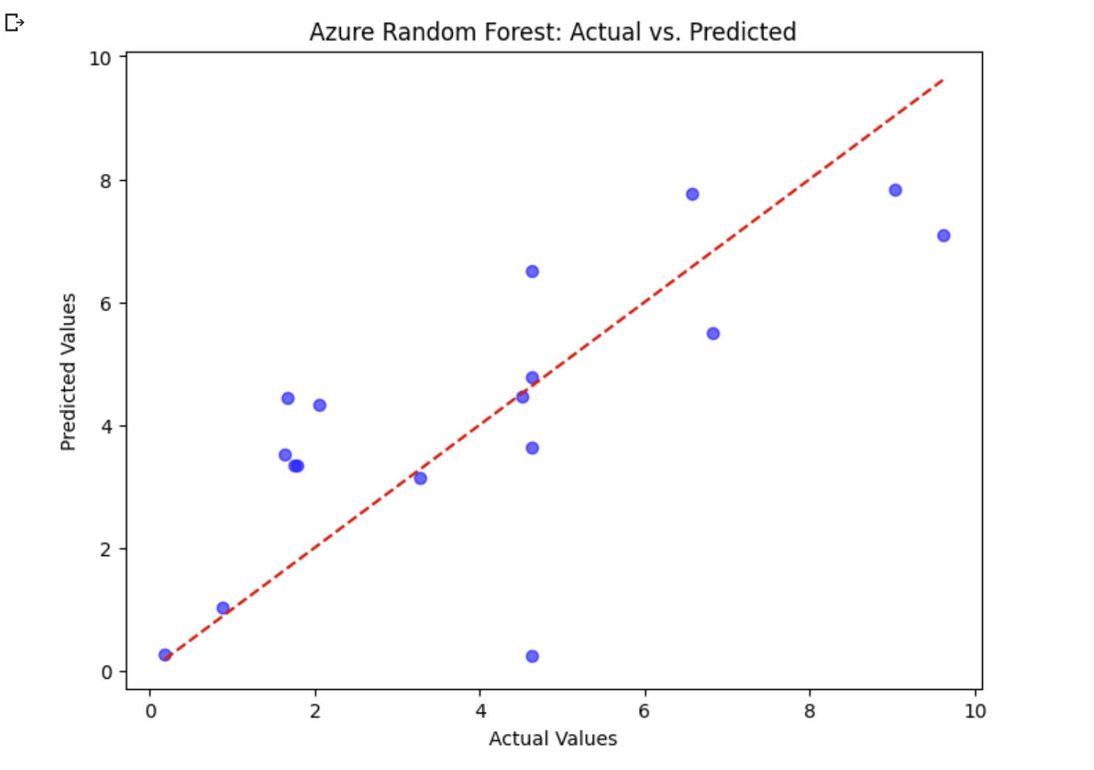
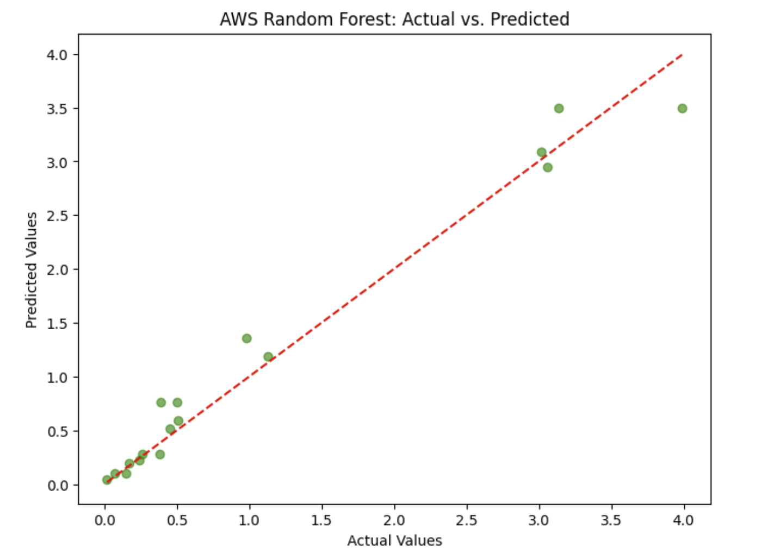
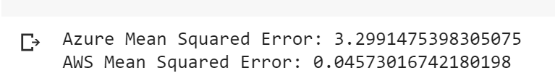
Predictive Modelling – Random Forest
AWS model has a higher level of accuracy in estimating the cost, resulting in smaller errors between the predicted and actual values.
Reduction in MSE for Azure: attributed to its ability to capture non-linear relationships, handle feature importance, leverage ensemble learning.

Slide 13
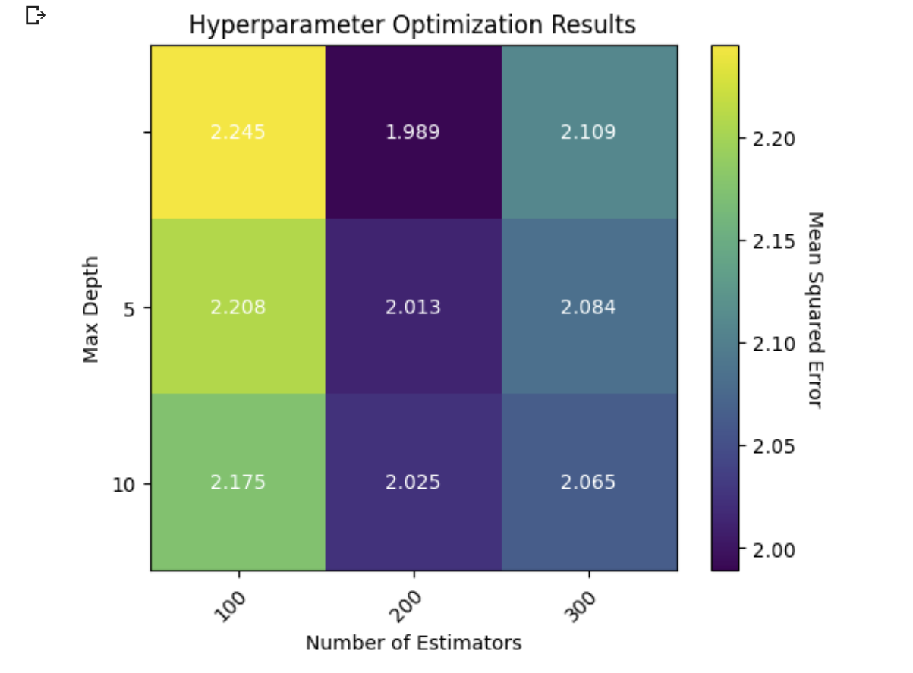
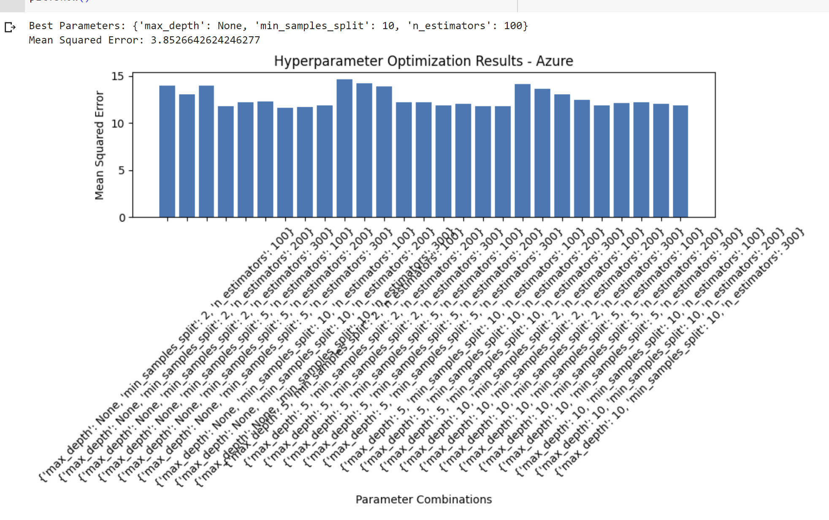
Hyperparameter Optimization
These results suggest that the Random Forest model with the identified best parameters may not provide the most accurate predictions for the On Demand cost in the Azure dataset. Further optimization or exploration of different algorithms is required.
Around 2.0 to 2.25, indicate the level of error in the model's predictions.
The color intensity represents the magnitude of the MSE, with darker colors indicating higher error values.

Slide 14
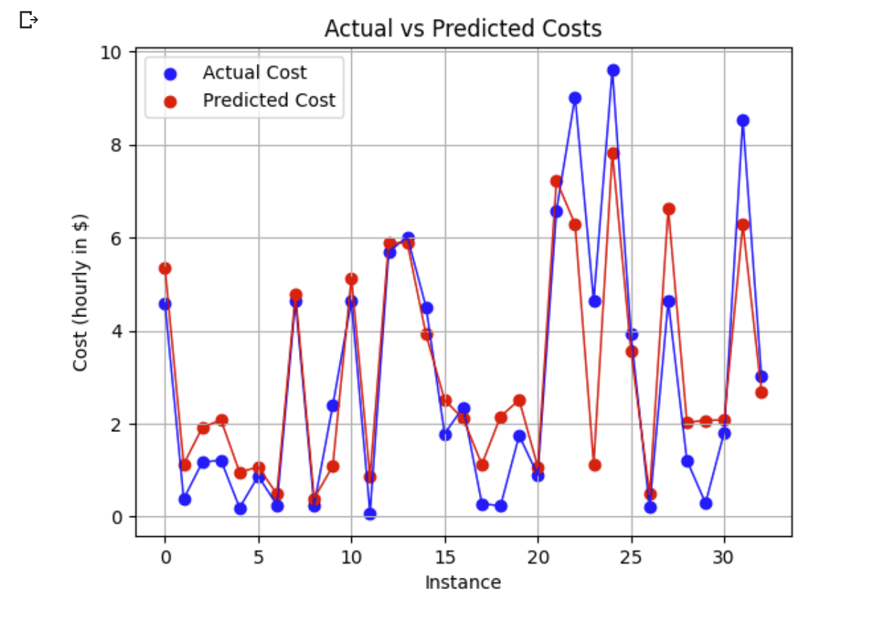
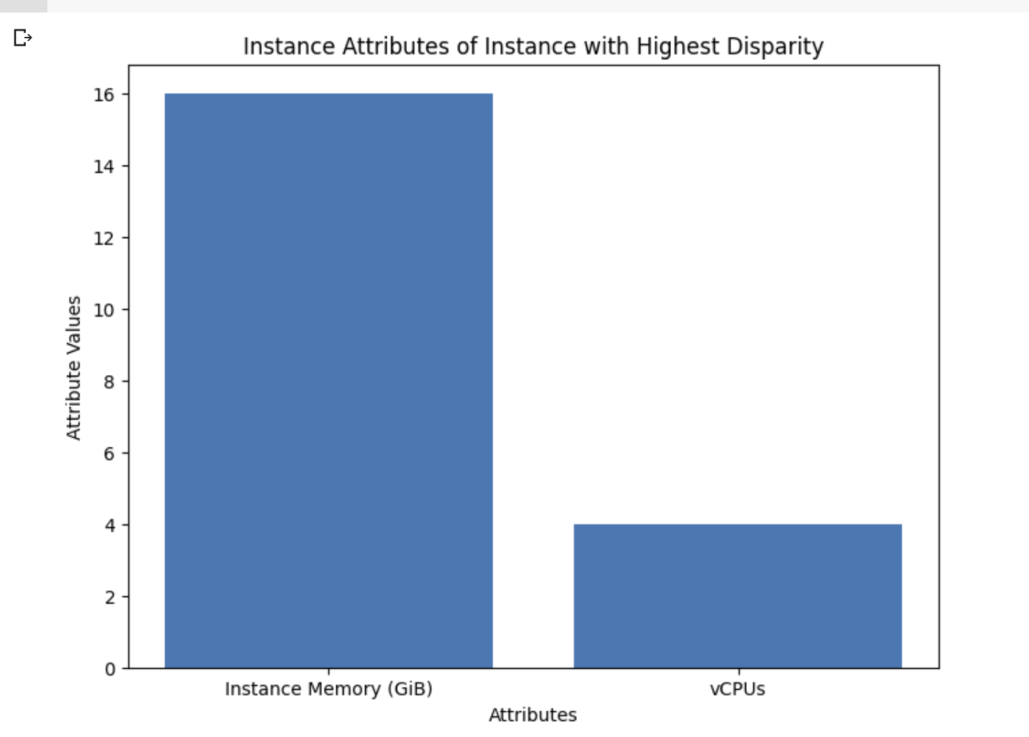
Cost Optimization Model – Random Forest Regressor
The model was able to optimally predict with exception to certain disparity.
The instances causing it was identified and can be investigated to identify the cause.
Name | API Name | Instance Memory (GiB) | vCPUs | Instance Storage | On Demand cost (hourly in $) | Windows Reserved cost (hourly in $) | Windows Spot cost (hourly in $) | Windows Savings Plan (hourly in $) | Reserved cost (hourly in $) | Reserved cost (hourly in $)
70 | B4ps v2 | B4ps v2 | 16.0 | 4 | 0 | 4.636771 | 0.0 | 1.020855 | 3.982566 | NaN
70 | R4 Memory Optimized Eight Extra Large | r4.8xlarge.search | 244.0 | 32 | EBS Only | 3.14 | NaN | NaN | NaN | 2.17

Slide 15
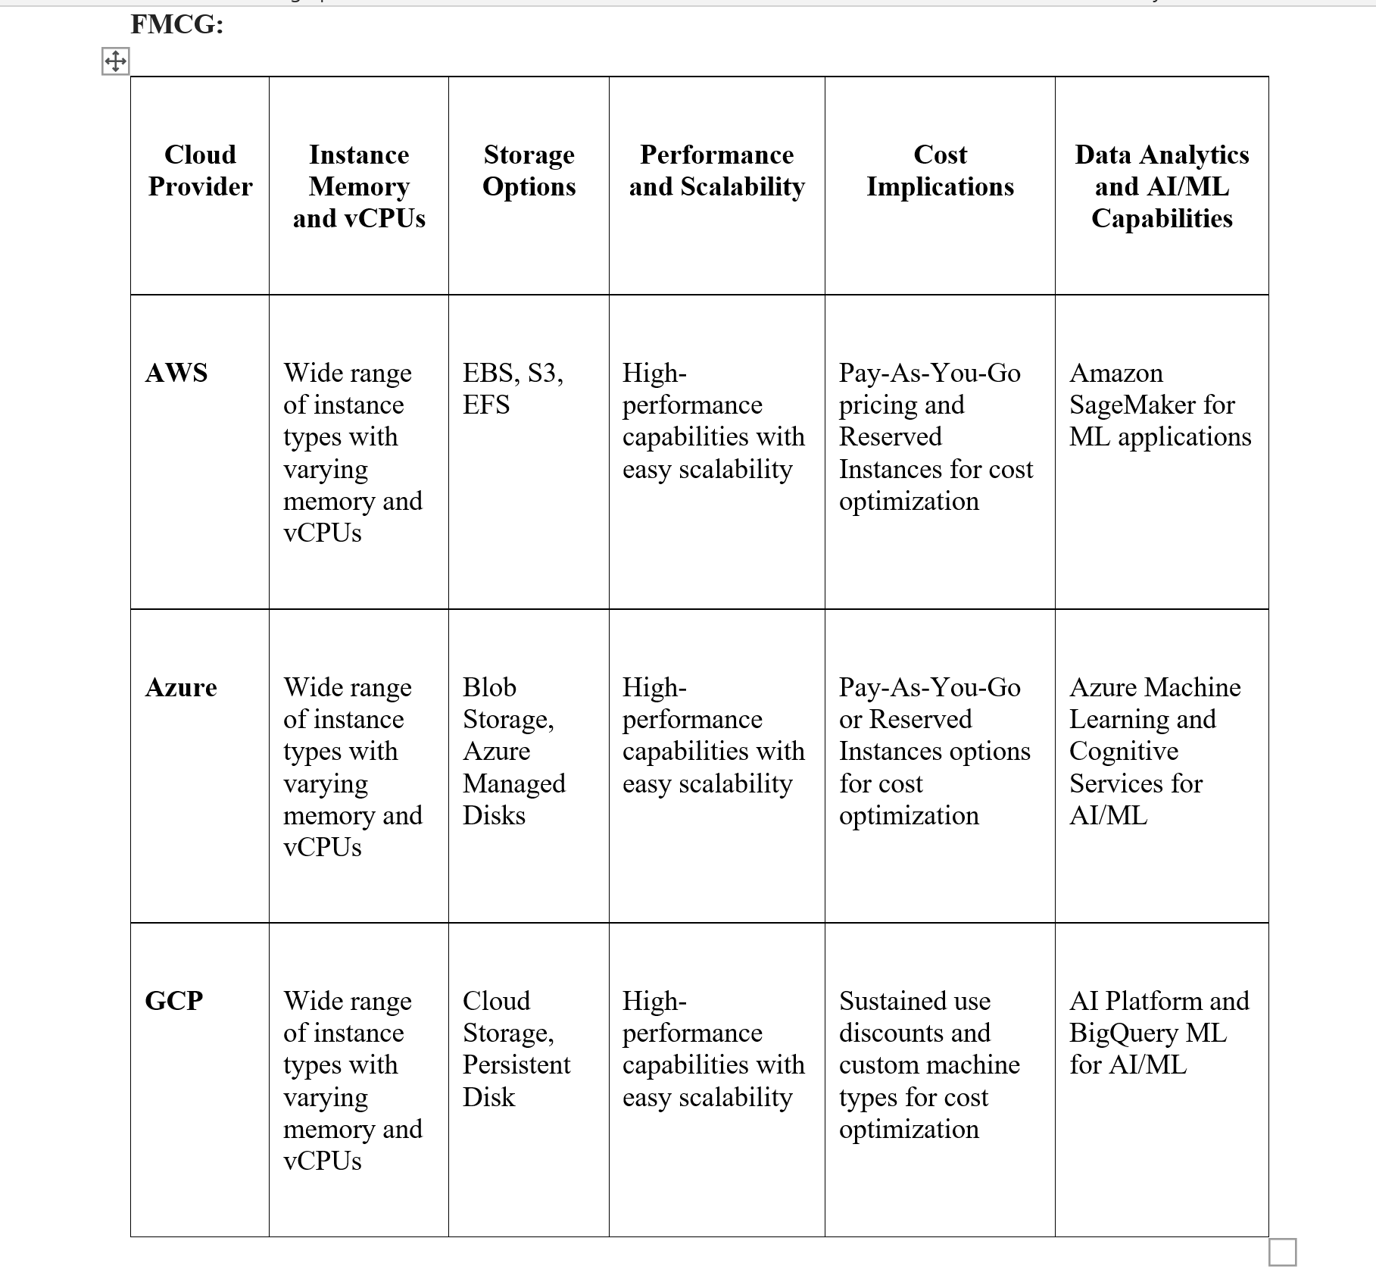
Cloud Offerings & Usage in FMCG industry
Company | Primary Cloud | Usage on Primary Cloud | Secondary Cloud | Usage on Secondary Cloud
P&G | Google Cloud Platform (GCP) | Consumer info into a data lake | Azure | Manufacturing apps on-premises servers to cloud-based Azure Ultra Disk Storage.
 |  | - Store and analyse marketing information |  | - Integrate data from more than 100 manufacturing sites worldwide and enhance AI, ML, and Edge computing.
Unilever | Azure | - Primary cloud platform, digitalization | Google Cloud Platform (GCP) | Sustainable Sourcing
Nestle | Azure | Private & Public cloud | N/A | N/A
 |  | - App hosting
The Coca-Cola Company | Google Cloud Platform (GCP) | - Software and cloud products | AWS | Migration & digital transformation
PepsiCo | Azure | - ERP, and data estate consolidation and modernization | N/A | N/A

Slide 16
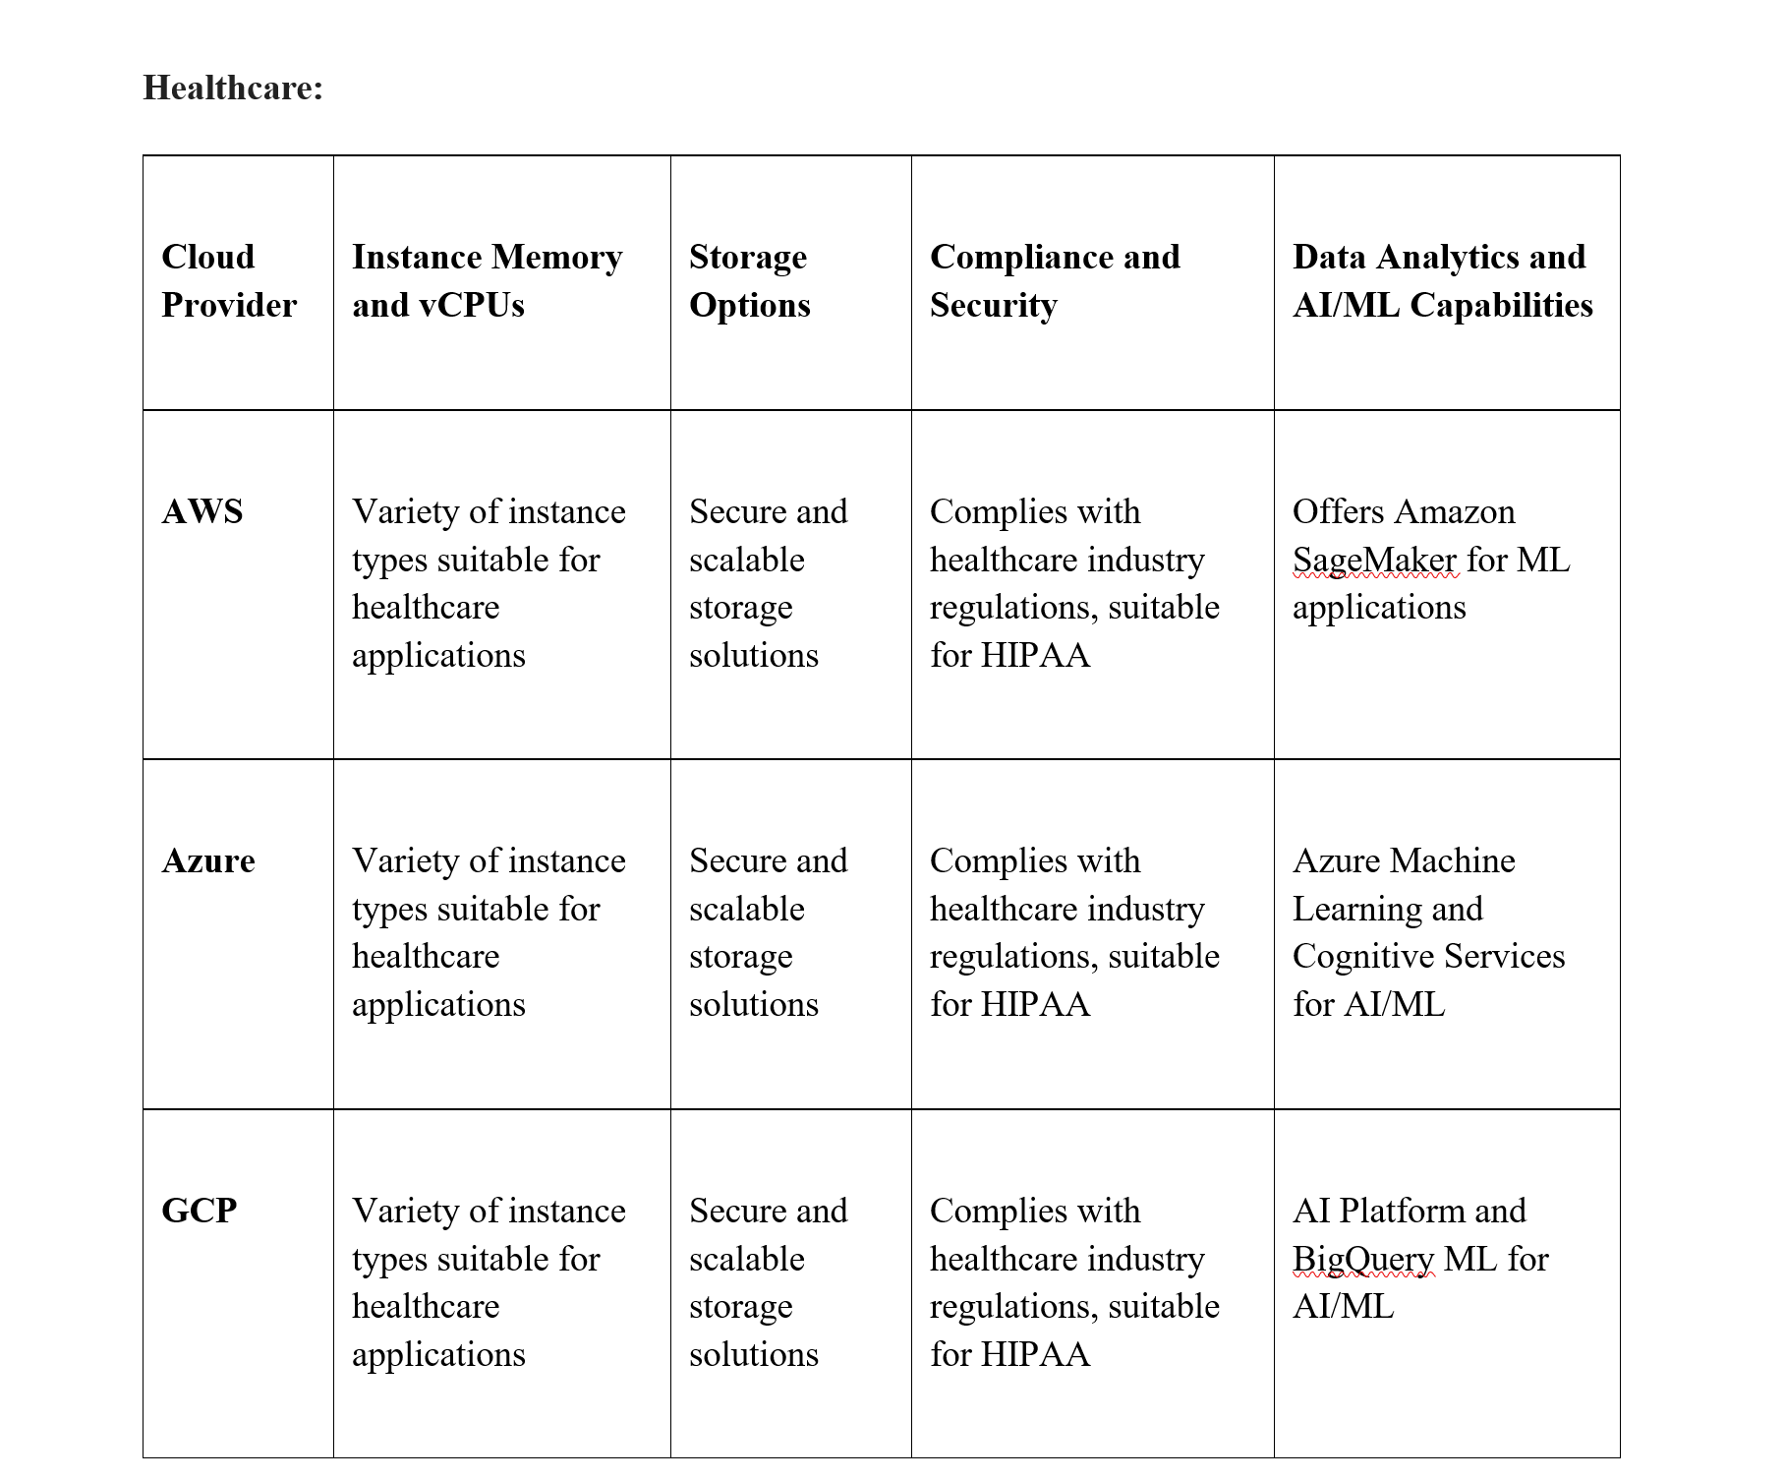
Cloud Offerings & Usage in Healthcare industry
Healthcare Organization | Primary Cloud | Usage on Primary Cloud | Secondary Cloud | Usage on Secondary Cloud
Apollo Hospitals | Azure | - Human capital management | Oracle | EMR
 |  |  | GCP | AI, ML tech, and diagnostics (clinical intelligence platform)
Manipal Hospitals | Azure | - App hosting and computing services | GCP | Digitalization
Fortis Healthcare | Azure | - All applications | N/A | N/A
Max Healthcare | AWS | - App hosting and computing services | Azure | IT
Dr. Reddy’s Laboratories | AWS | -Primary cloud provider | N/A | N/A

Slide 17
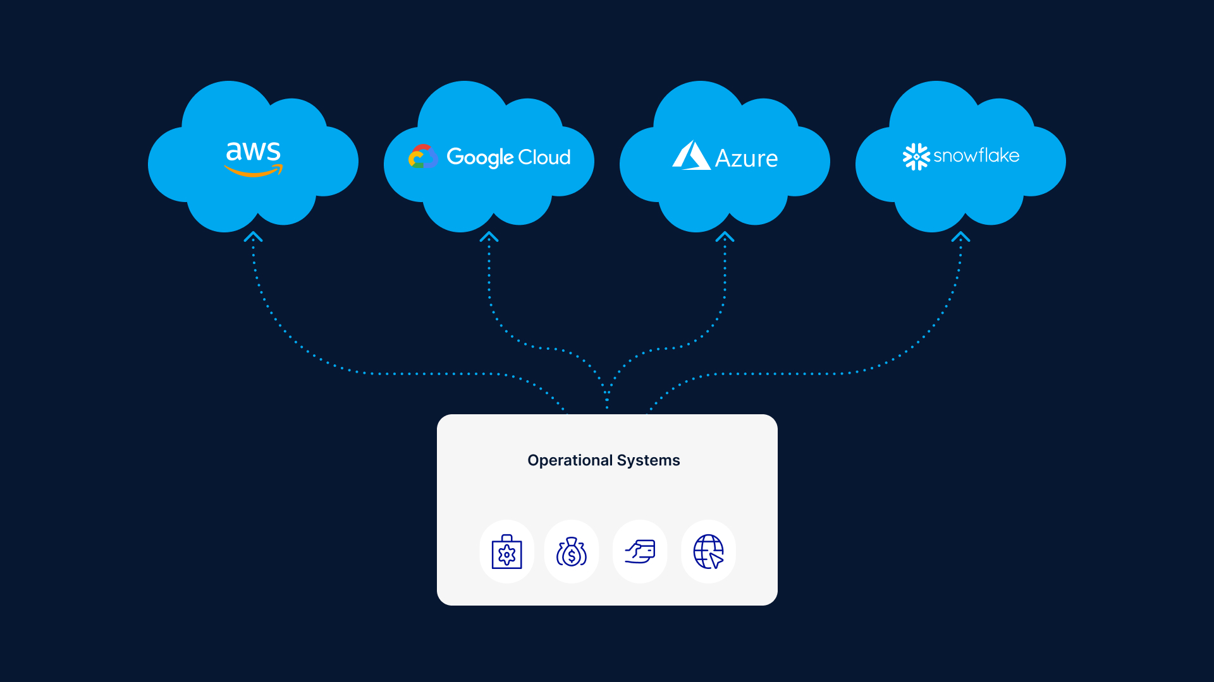
Parameters affecting the choice
Factors affecting the Choice:
Workload Characteristics
Cost and Budget
Data Sensitivity
Geographical Presence
Integration and Compatibility
Regulatory Compliance
Vendor Expertise and Support
Data Migration and Portability
Multi-cloud Strategy

Slide 18
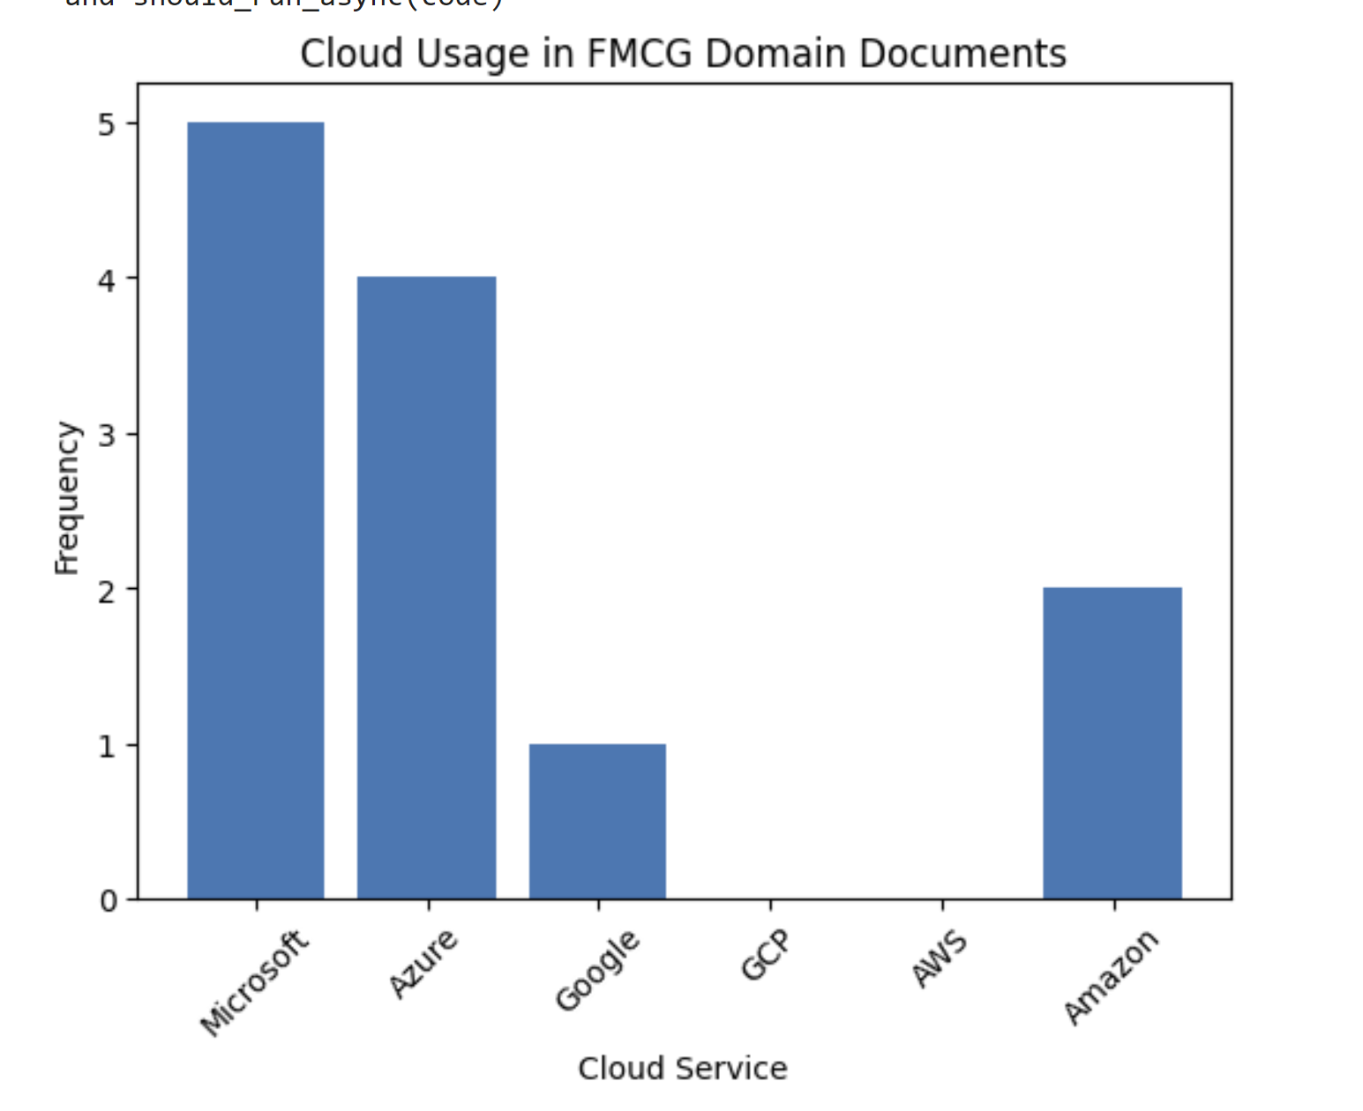
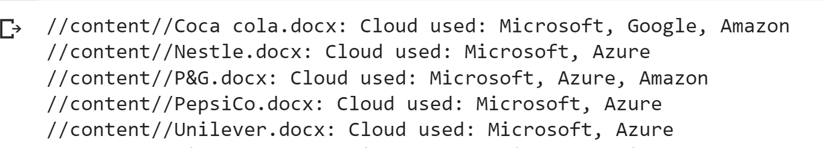
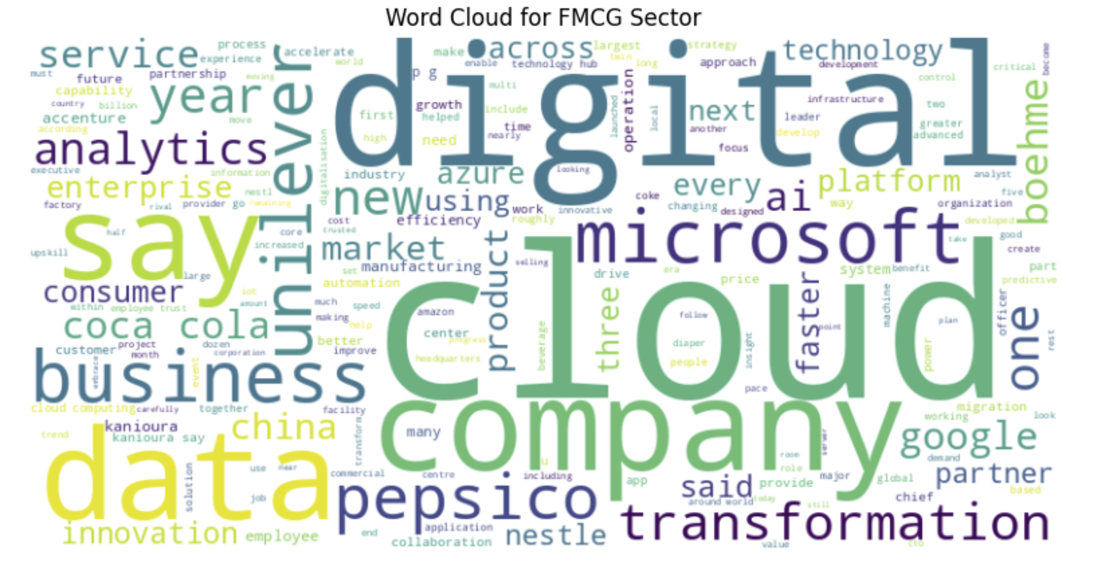
Text Analysis on FMCG articles

Slide 19
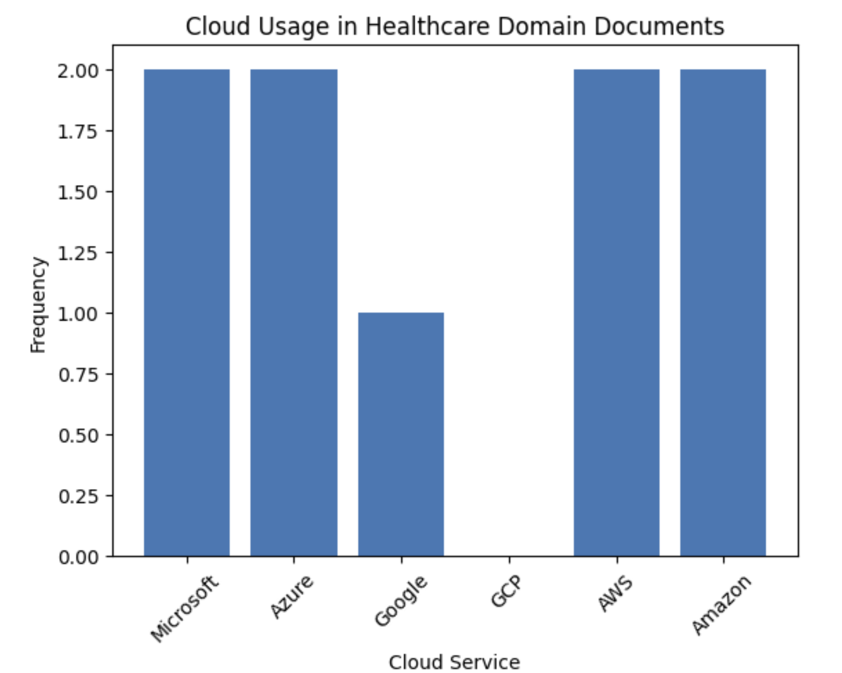
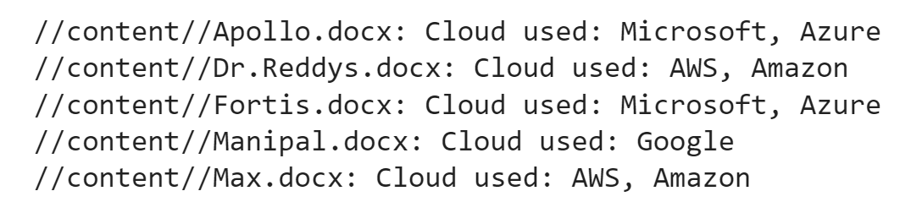
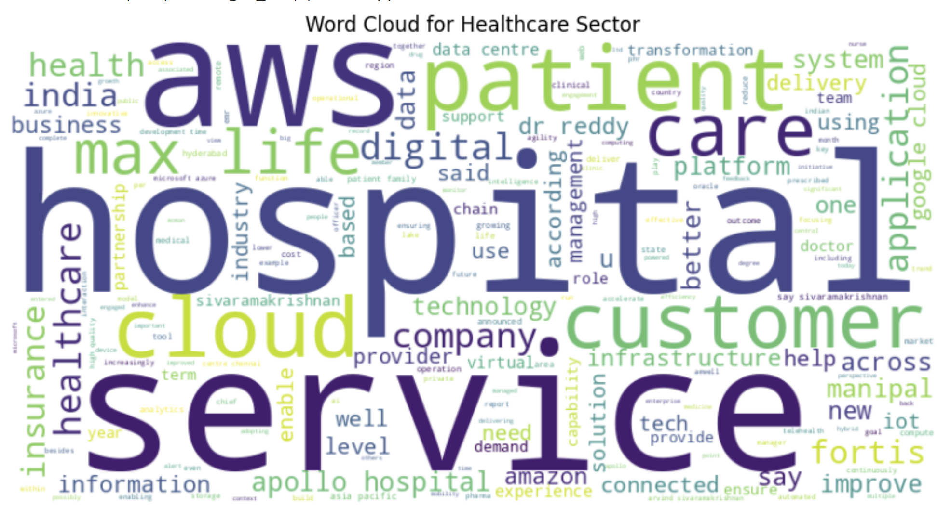
Text Analysis on Healthcare articles

Slide 20
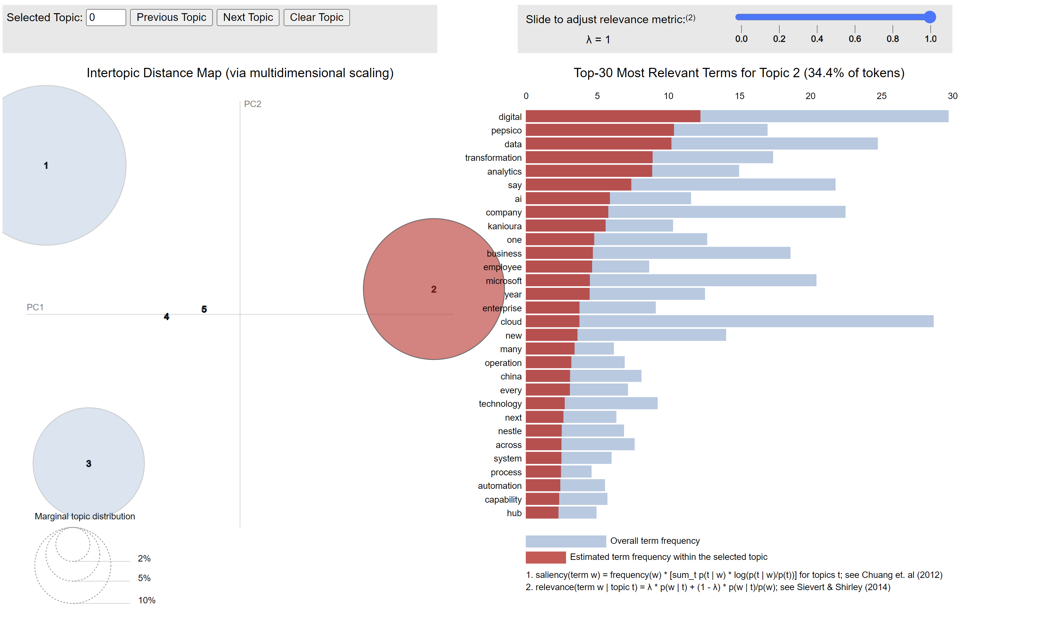
LDA on FMCG articles
Microsoft's Azure: It suggests that Azure is widely adopted by FMCG companies for their cloud computing needs.
Google Cloud Platform (GCP): This indicates that FMCG companies also utilize GCP for various cloud-related purposes.
Amazon Web Services (AWS): This suggests that AWS is a popular choice among FMCG companies for cloud services.
General Cloud Concepts: It indicates a wide discussion of cloud technologies in the FMCG domain, possibly covering general cloud strategies and applications.
Cloud Vendor Comparisons: Keywords like "service," "cloud," and "platform" suggest an analysis of different cloud providers in the FMCG sector, aiding companies in making informed cloud service decisions.

Slide 21
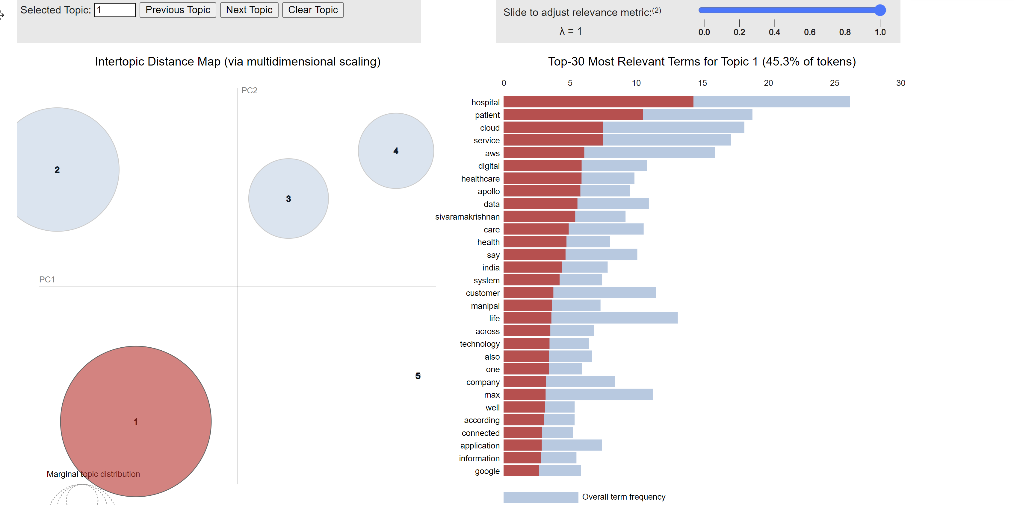
LDA on Healthcare articles
Microsoft's Azure: It indicates that Microsoft's cloud platform is widely used in the healthcare sector.
Google Cloud Platform (GCP): This suggests that healthcare companies also utilize GCP for various cloud-related purposes.
Amazon Web Services (AWS): This implies that AWS is another popular choice among healthcare companies for cloud services.
General Cloud Concepts: It suggests a broader discussion of cloud technologies in the healthcare domain, possibly covering general cloud strategies and applications.
Cloud Vendor Comparisons: Keywords like "service," "cloud," and "platform" indicate a comparative analysis of different cloud providers in the healthcare sector, helping companies make informed cloud service decisions.

Slide 22
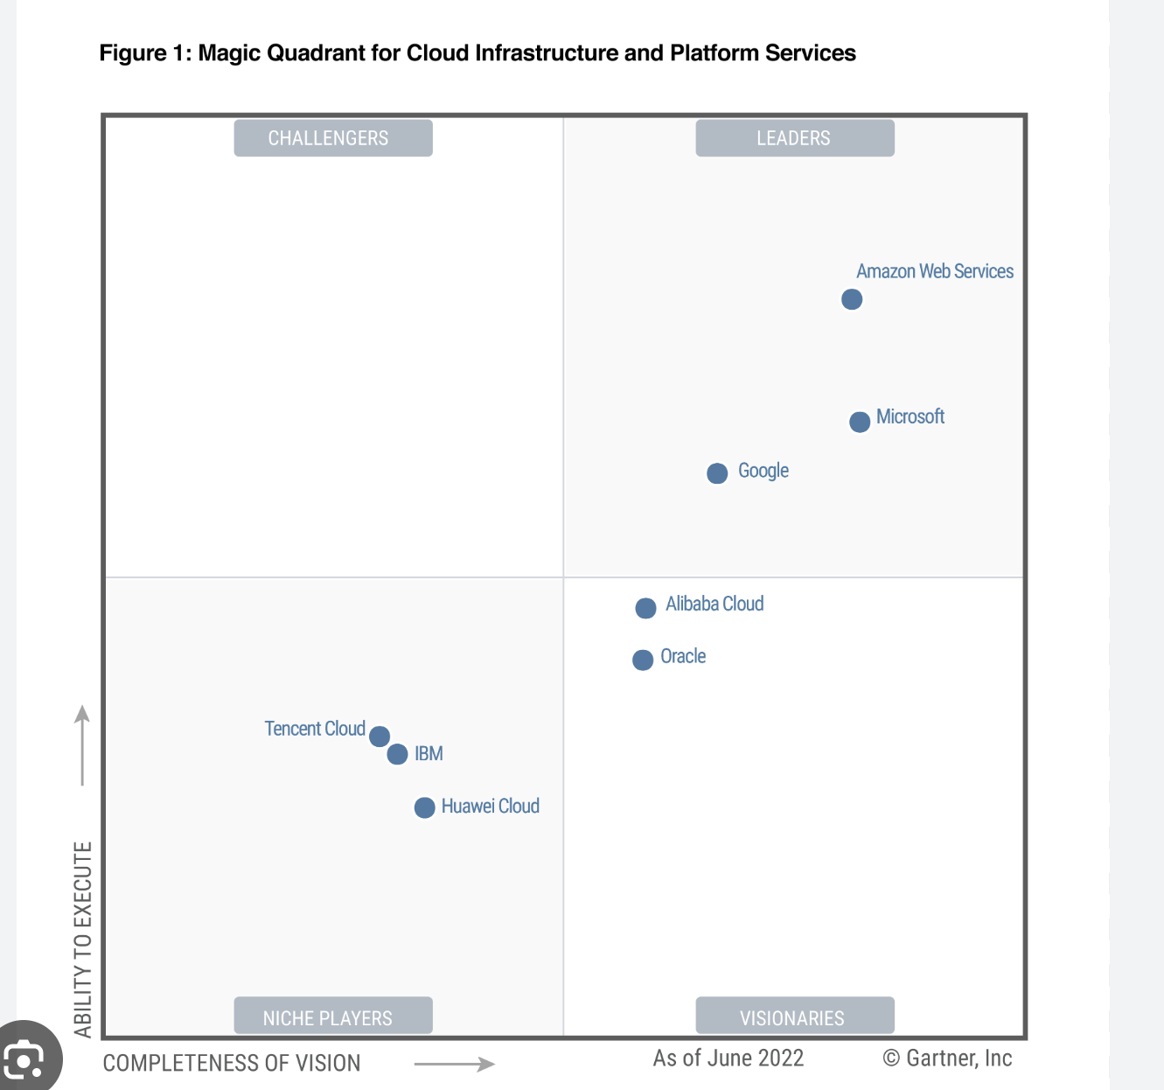
Gartner magic quadrant for Cloud Services: 2022
Leaders (AWS, Azure, and GCP):
Well-established, strong market presence, and offer complete cloud solution with substantial resources and complex needs.
Niche Players (Tencent Cloud, IBM, Huawei Cloud):
Specialized offerings or cater to specific use cases. Both large enterprises and smaller organizations with specific needs.
Visionaries (Alibaba Cloud, Oracle Cloud):
Unique services, cutting-edge technologies, and adaptable to specific industry requirements
Large enterprises/organizations: Target Leaders
Small & medium sized, New entrants: Choose between Niche and Visionaries

Slide 23
Findings
Performance Comparison: AWS instances have lower average instance memory and vCPUs compared to Azure.
Cost Implication: Azure has a higher mean on-demand cost compared to AWS.
Predictive Modeling: Random Forest outperformed Linear Regression in predicting costs for both Azure and AWS instances.
Cost Optimization: A Random Forest Regressor model was used to estimate total cost based on instance attributes with a couple of outliers.
Most organizations have ventured into multi-cloud strategy and Azure currently stands out in terms of performance and offerings.
A number of parameters based on the domain, size and capabilities of the organization are considered while opting a cloud service.

Slide 24
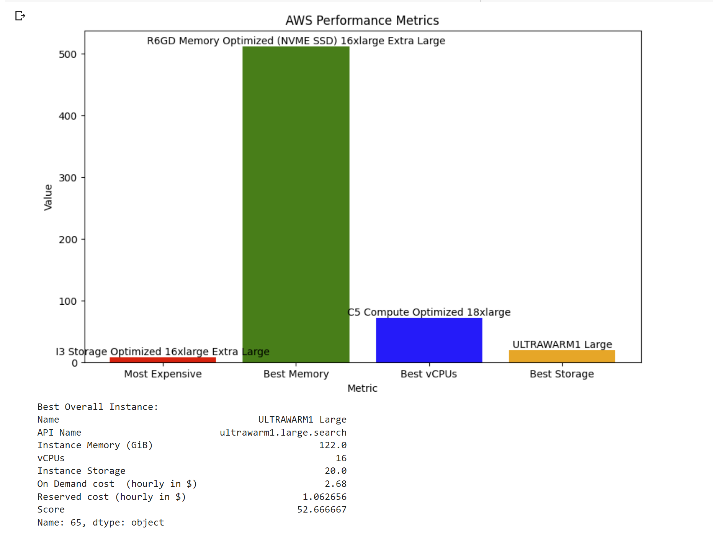
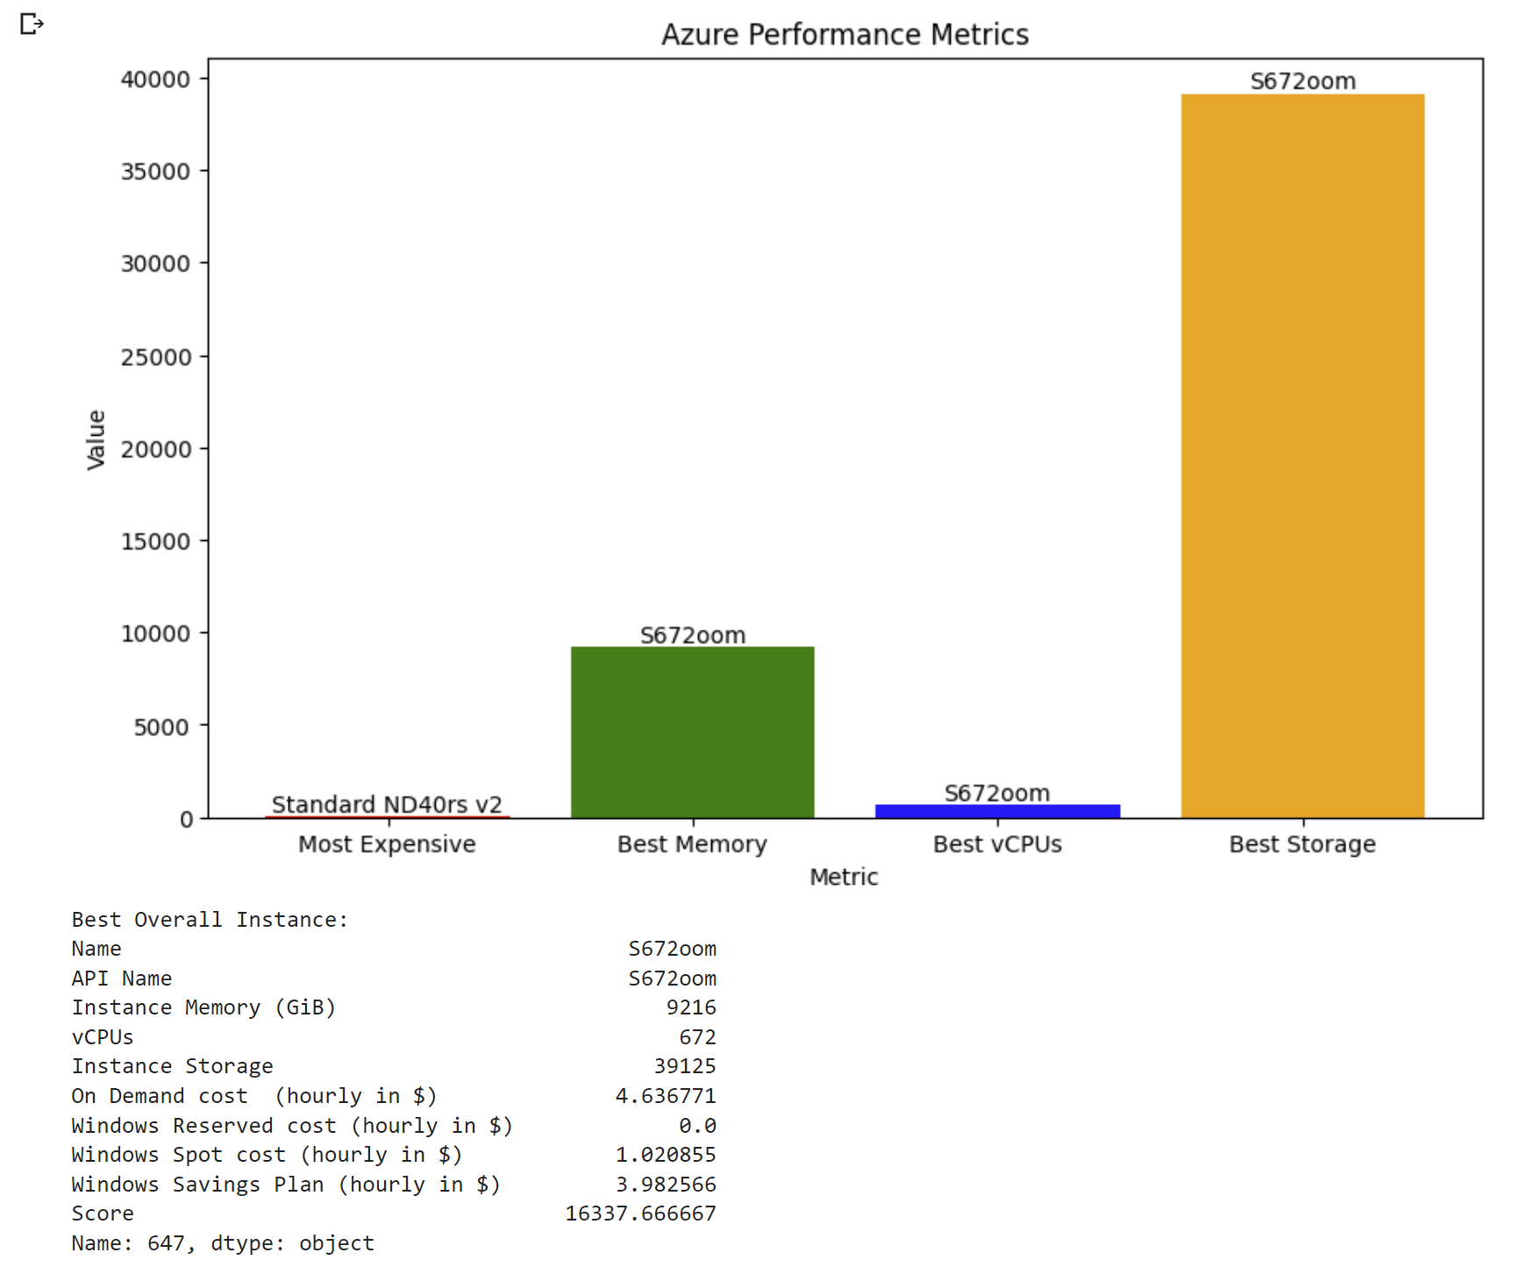
Conclusion
AWS instances generally offer higher memory and vCPU capacity compared to Azure, making it suitable choice for resource-intensive applications and workloads.
The developed cost optimization model using random forest regression enables KeyUp Technologies to estimate total costs based on instance attributes.
FMCG: All three cloud service providers AWS, Azure, and GCP offer complete solutions for the FMCG sector's unique cloud service needs. The decision between these providers ought to be influenced by things like current infrastructure, application compatibility, and financial constraints.
Healthcare: Azure stands out as a good option for the healthcare industry because of its advanced AI and ML capabilities, which are useful for healthcare analytics and diagnostics. Additionally, Azure is a trustworthy choice for healthcare firms since it complies with industry laws like HIPAA, which guarantees data protection and privacy.
Further recommendation for a multi-cloud approach owing to several advantages for the two domains.

Slide 25
Learnings & Skills gained
In-depth understanding of Cloud services
Better experience with machine learning models
Learnt cost optimization models and their application
Learnt Text Analysis – data collection, cleaning and topic analysis
Got an introduction to Power BI
Developed Excel skills

Slide 26
Value added to the Organization
Involved in sales pitches
Contributed in developing presentations and reports
Recommended the implementation of a centralized dashboard with information regarding resell products
Suggested for a better online presence and as to improve their SEO.

Slide 27
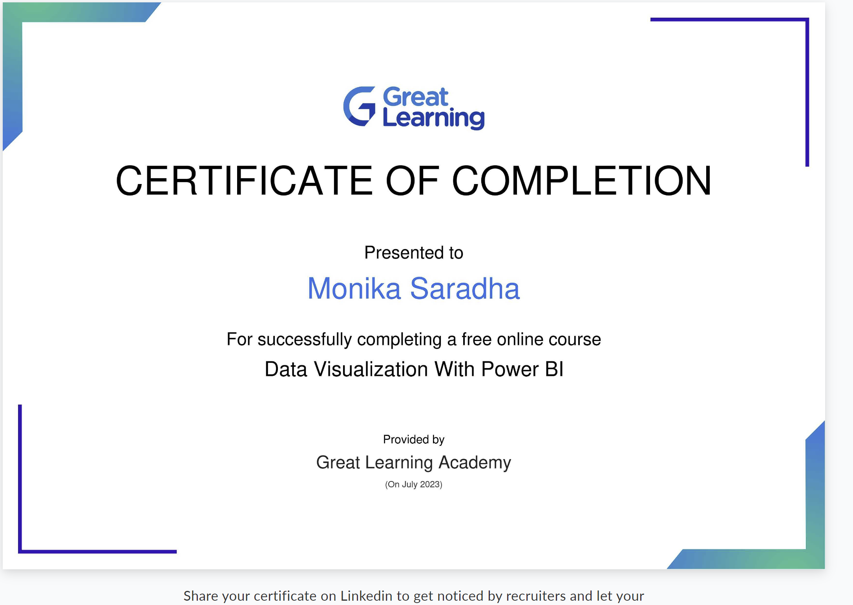
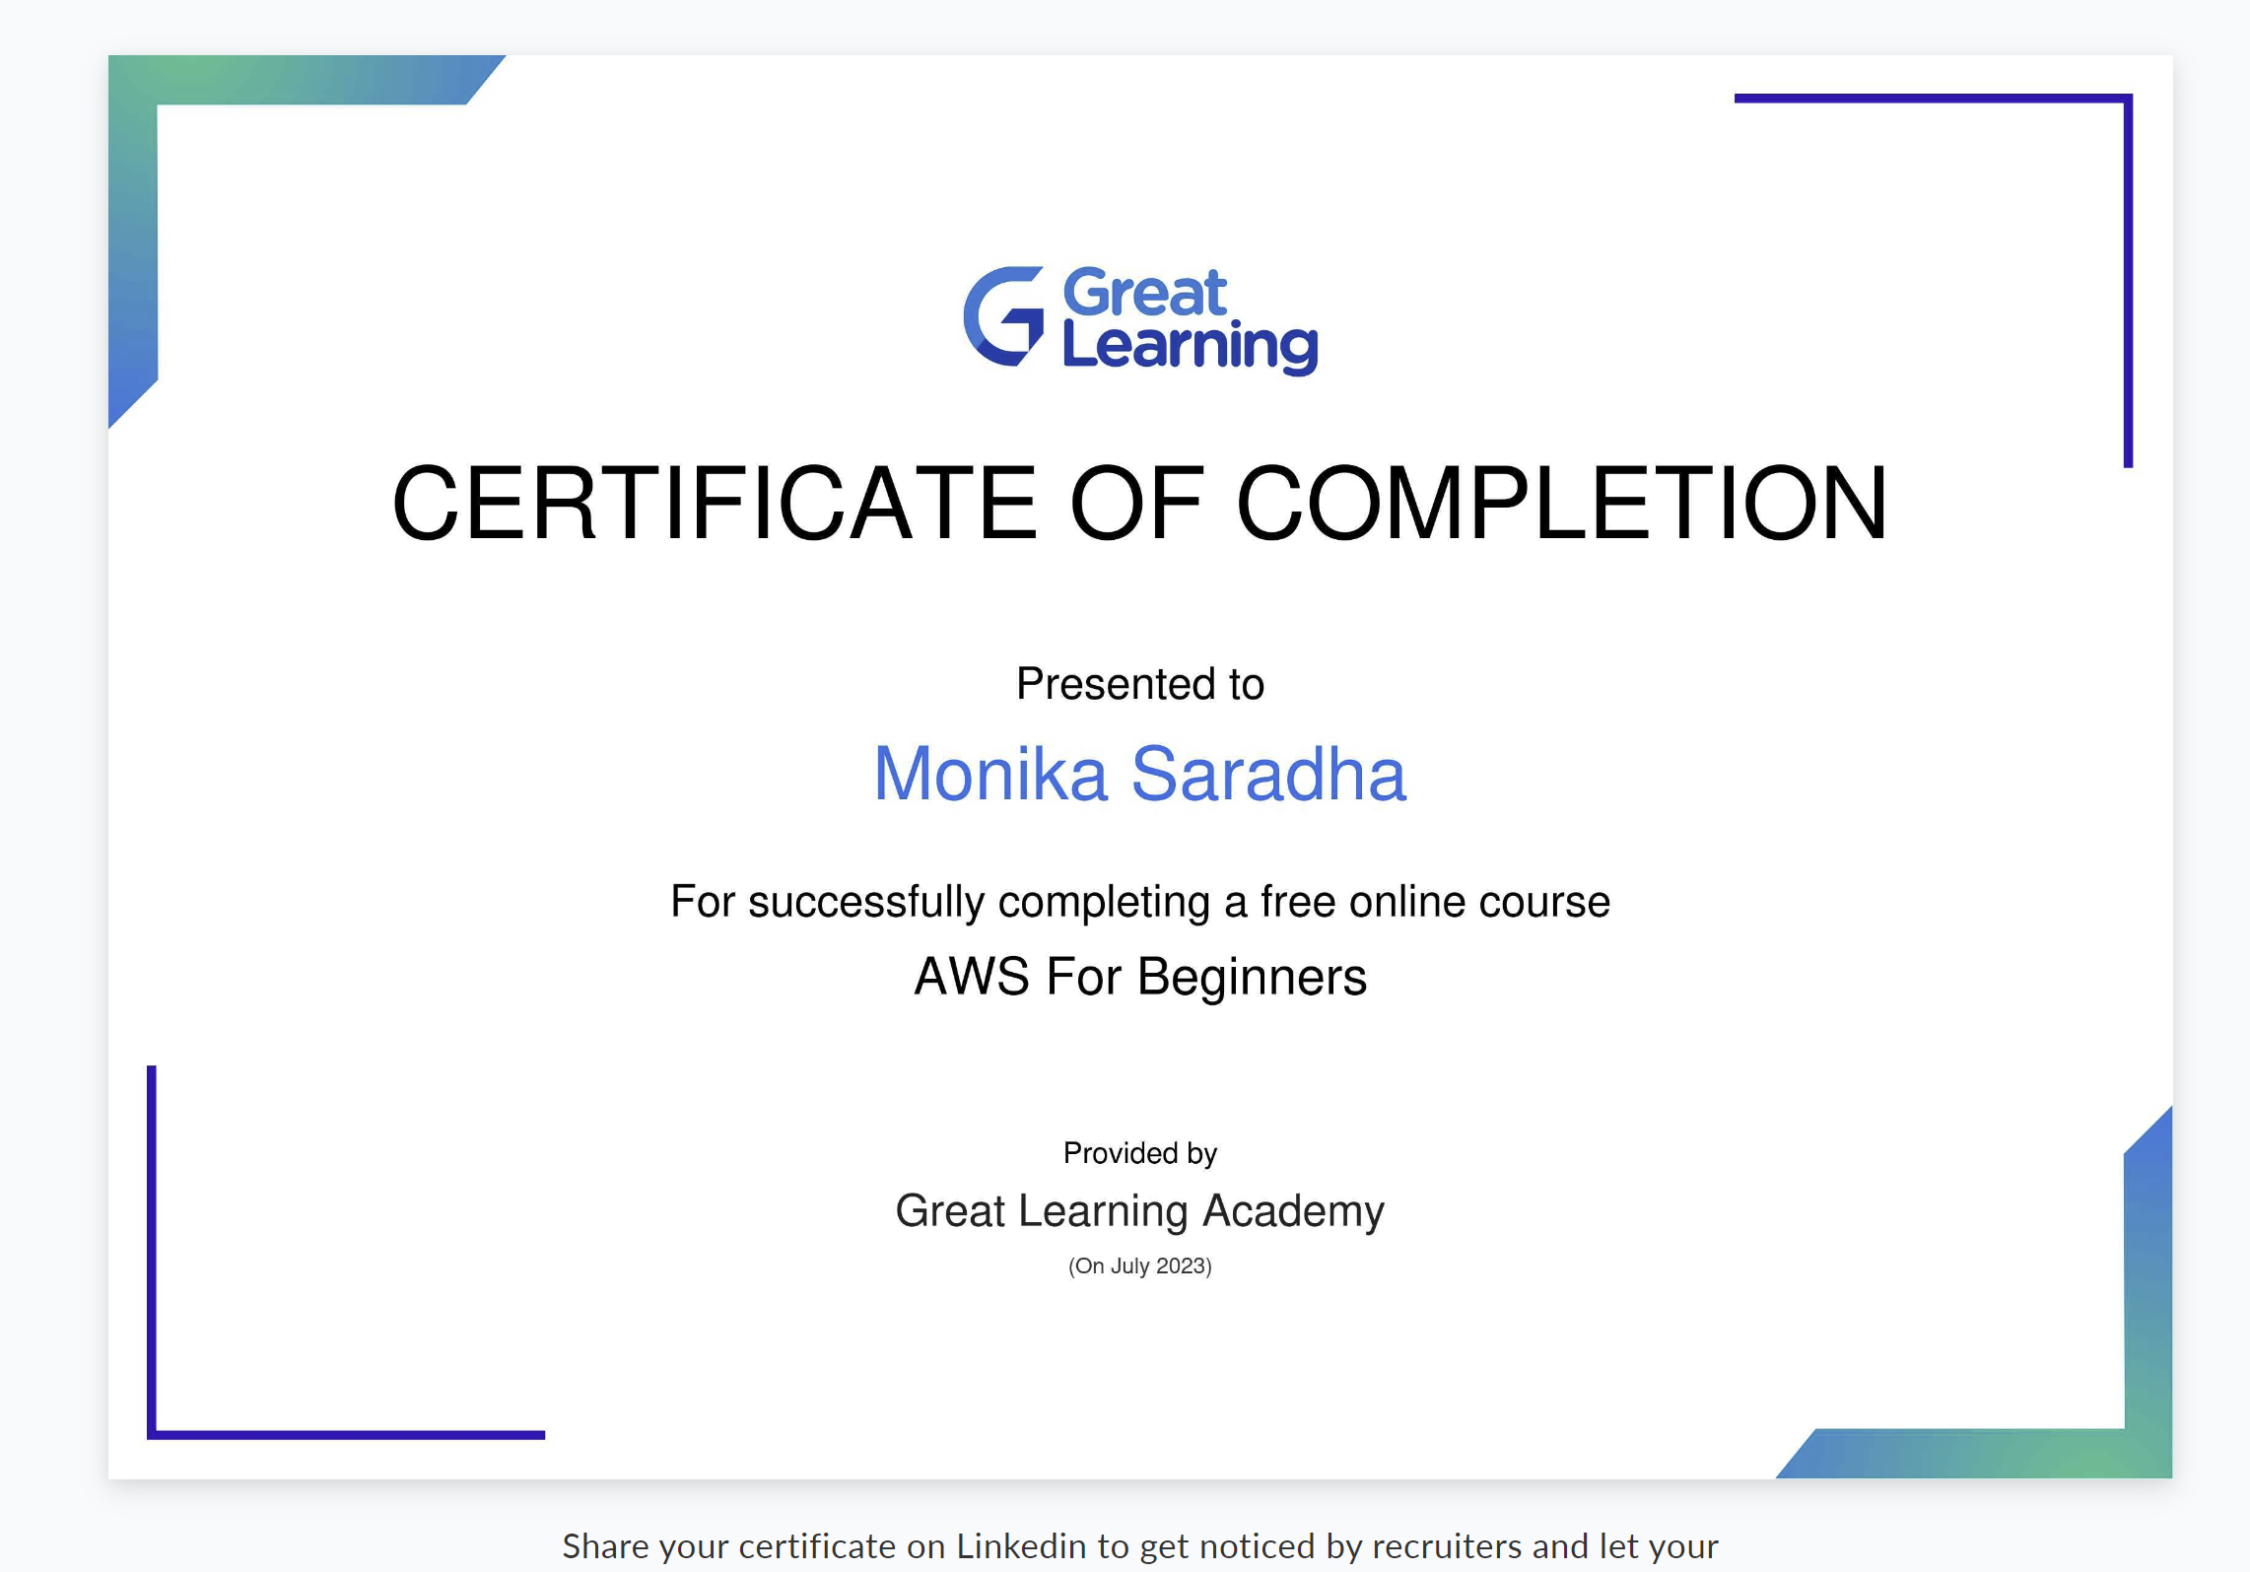
Online Course Certificates

Slide 28
